Slide 1
What Does It Mean to Be Presbyterian?
Week 3: Presbyterian Polity

Slide 2
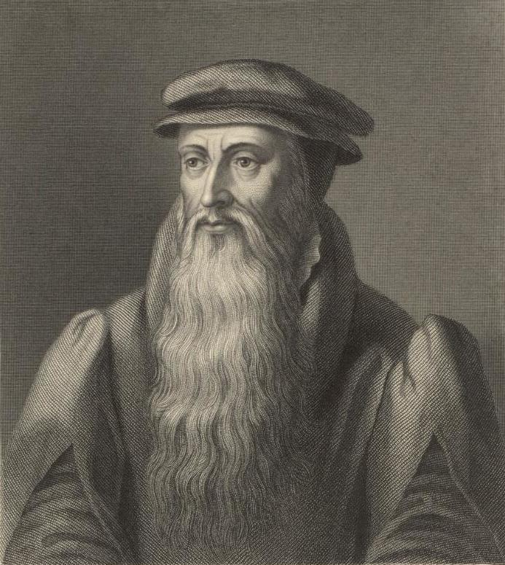
What Is Polity?
“Good policy and order should be constituted and observed in the Kirk where, as in the house of God, it becomes all things to be done decently and in order.”
–The Scots Confession

Slide 3
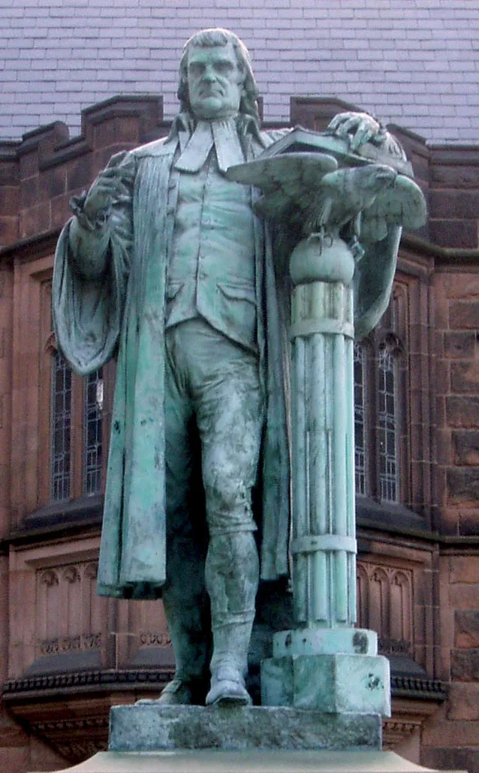
Fundamentals of Presbyterian Polity
Presbyterian polity is:
Constitutional
Representative
Conciliar

Slide 4
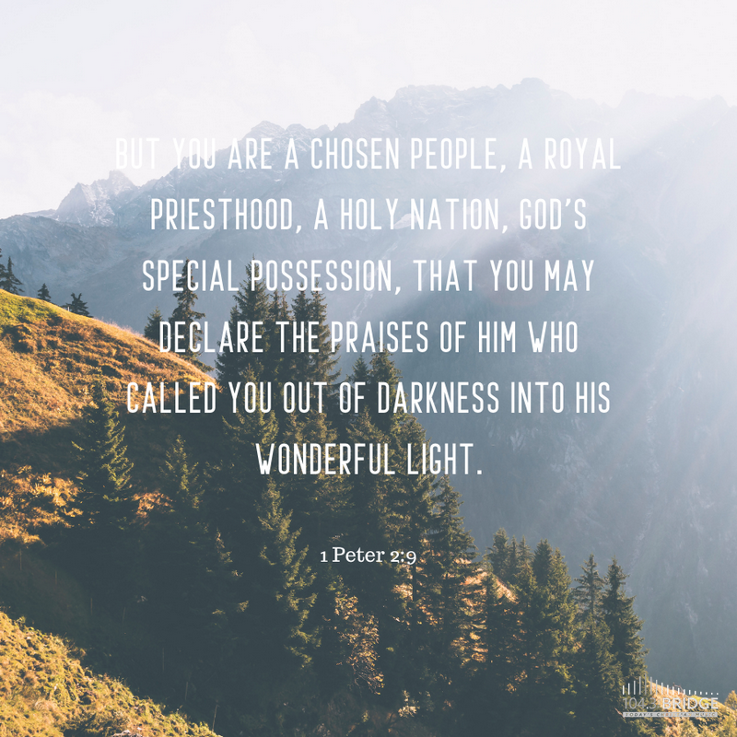
Presbyterian Ministers
Every church member!
Deacons
Ruling Elders
Teaching Elders

Slide 5
The Calling of Church Membership
Proclaiming the good news in word and deed
Taking part in the common life and worship of a congregation
Lifting one another up in prayer, mutual concern, and active support
Studying Scripture and the issues of Christian faith and life
Supporting the ministry of the church through the giving of money, time, and talents
Demonstrating a new quality of life within and through the church
Responding to God’s activity in the world through service to others
Living responsibly in the personal, family, vocational, political, cultural, and social relationships of life
Working in the world for peace, justice, freedom, and human fulfillment
Caring for God’s creation
Participating in the governing responsibilities of the church
Reviewing and evaluating regularly the integrity of one’s membership, and considering ways in which one’s participation in the worship and service of the church may be increased and made more meaningful
G-1.0304

Slide 6
The Calling of Ordered Ministry
Teaching Elders
Ruling Elders
Deacons
Will you be a faithful minister
of the Word and Sacrament, proclaiming the good news in Word and Sacrament, teaching faith and caring for people? Will you be active in government and discipline, serving in the councils of the church; and in your ministry will you try to show the love and justice of Jesus Christ?
Will you be a faithful ruling elder, watching over the people, providing for their worship, nurture, and service? Will you share in government and discipline, serving in councils of the church, and in your ministry will you try to show the love and justice of Jesus Christ?
Will you be a faithful deacon, teaching charity, urging concern, and directing the people’s help to the friendless and those in need, and in your ministry will you try to show the love and justice of Jesus Christ?

Slide 7
The Session
Leads and equips congregation for evangelism and outreach
Receives new members
Keeps accurate membership rolls
Makes provision for preaching and Sacraments
Authorizes Sacraments
Oversees and approves all public worship
Develops and supervises educational programs
Establishes congregational budget
Creates committees and commissions
Oversees all other church organizations
Provides for property management
Provides for staff compensation, etc.
Calls congregational meetings
Provides for pastoral care, fellowship, opportunities for witness and service
Instructs, examines, ordains, and trains new ruling elders and deacons
Supports inquirers and candidates for teaching elder
Carries out higher councils’ instructions
Proposes overtures to higher councils
Corrects patterns of discrimination

Slide 8
The Pastor
Studying, teaching, and preaching the Word
Celebrating the Sacraments
Providing pastoral care, especially to the poor, the sick, the troubled, and the dying
Praying with and for the congregation
Serving as a member of Session and its moderator
Equipping the people for ministry
Selecting Scriptures
Selecting hymns and other art forms for use in worship
Participating in church governance and ecumenical relationships
Maintaining a lifestyle that “commends the gospel to all persons” and “communicates its joy and justice”

Slide 9
PC(USA) Denominational
Structure
General Assembly
Synods
Presbyteries
Sessions

Slide 10
Church Conflict, Presbyterian-Style!
Freedom of conscience, subject to the Word and the authority of the Church as it flows from the Word
Majority rule
Collective discernment
Procedural fairness and regularity
Disagreeing well: options for dissent and protest
Administrative review by higher councils

Slide 11
Church Disciplinary Cases
A last resort, after sincere efforts at conciliation, mediation, and settlement have broken down
Goals: honoring God, preserving purity of the church, correcting wrongdoing, bringing repentance and restoration, upholding dignity of those harmed, restoring church unity, and securing just outcomes
Two kinds of Permanent Judicial Commission cases:
Remedial cases (to prevent or correct irregularities or delinquencies of councils)
E.g., a church member complaining to presbytery against session
Disciplinary cases (to prevent or correct offenses by persons)
E.g., a presbytery investigative committee prosecutes a teaching elder on charges of sexual abuse
Finding of guilt can result in rebuke, supervised rehabilitation, or temporary or permanent removal from ordered ministry or membership

Slide 12
How to Make Change in the PC(USA)
Pray
Participate and vote in congregational meetings
Nominate yourself or others for ordination as a Ruling Elder or Deacon
Serve on committees or commissions
Ask councils to take desired actions (informally or formally)
Be a representative to higher councils
Consider a call to ministry of Word and Sacrament
Bring overtures for constitutional amendment
Make “good trouble”

Slide 13
Special Thanks
Gray, Joan S., and Joyce C. Tucker. Presbyterian Polity for Church Leaders. 4th ed. Louisville, KY: Westminster John Knox Press, 2022.
Wilton, Carlos E. Principles of Presbyterian Polity. Second. Louisville, KY: Westminster John Knox Press, 2022.

